Slide 1
Backend Engineering-I Project
Jobify - Job Application Portal
Team Details: Group – 23,
2310990661 : Muskan Aggarwal
2310992027 : Jeeya Sharma
2310992029 : Kanika Prabhakar
2310992032 : Kartik Sharma
Faculty Coordinator: Ms. Vijaita Kashyap
:
Chitkara University Institute of Engineering and Technology,
Chitkara University, Punjab

Slide 2
Table of Contents
Introduction
Problem Statement
Technical Details
Key Features
Project Highlights
Conclusion
References/Links used

Slide 3
Introduction
JOBIFY - JOB APPLICATION PORTAL
Objectives:
Simplifies the job searching process by providing a simple and user-friendly interface.
Focuses on form validation and data management.

Slide 4
Problem Statement
Lack of proper validation
Complex website design
Data entry errors
Jobify - A portal that ensures data validation and stores it in a JSON format.

Slide 5
Technical Details
3.1 Front End : HTML , CSS , JavaScript
3.2 Back End : Node.js
3.3 Applications Used : Visual Studio Code
3.4 Application :
JavaScript used for form validation in front end.
Node.js used to create a HTTP server to process form submissions and manage user data stored in a JSON file.
JSON files used for simple data storage.

Slide 6
Key Features
Key features of the portal:
Form validation to ensure valid input data
JSON data storage to save data in a structured format for easy access and management
User friendly interface for easy usage

Slide 7
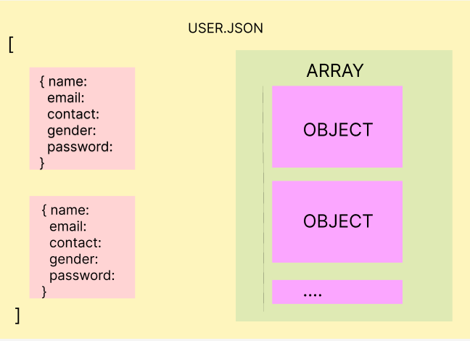
Key Features
JSON Structure

Slide 8
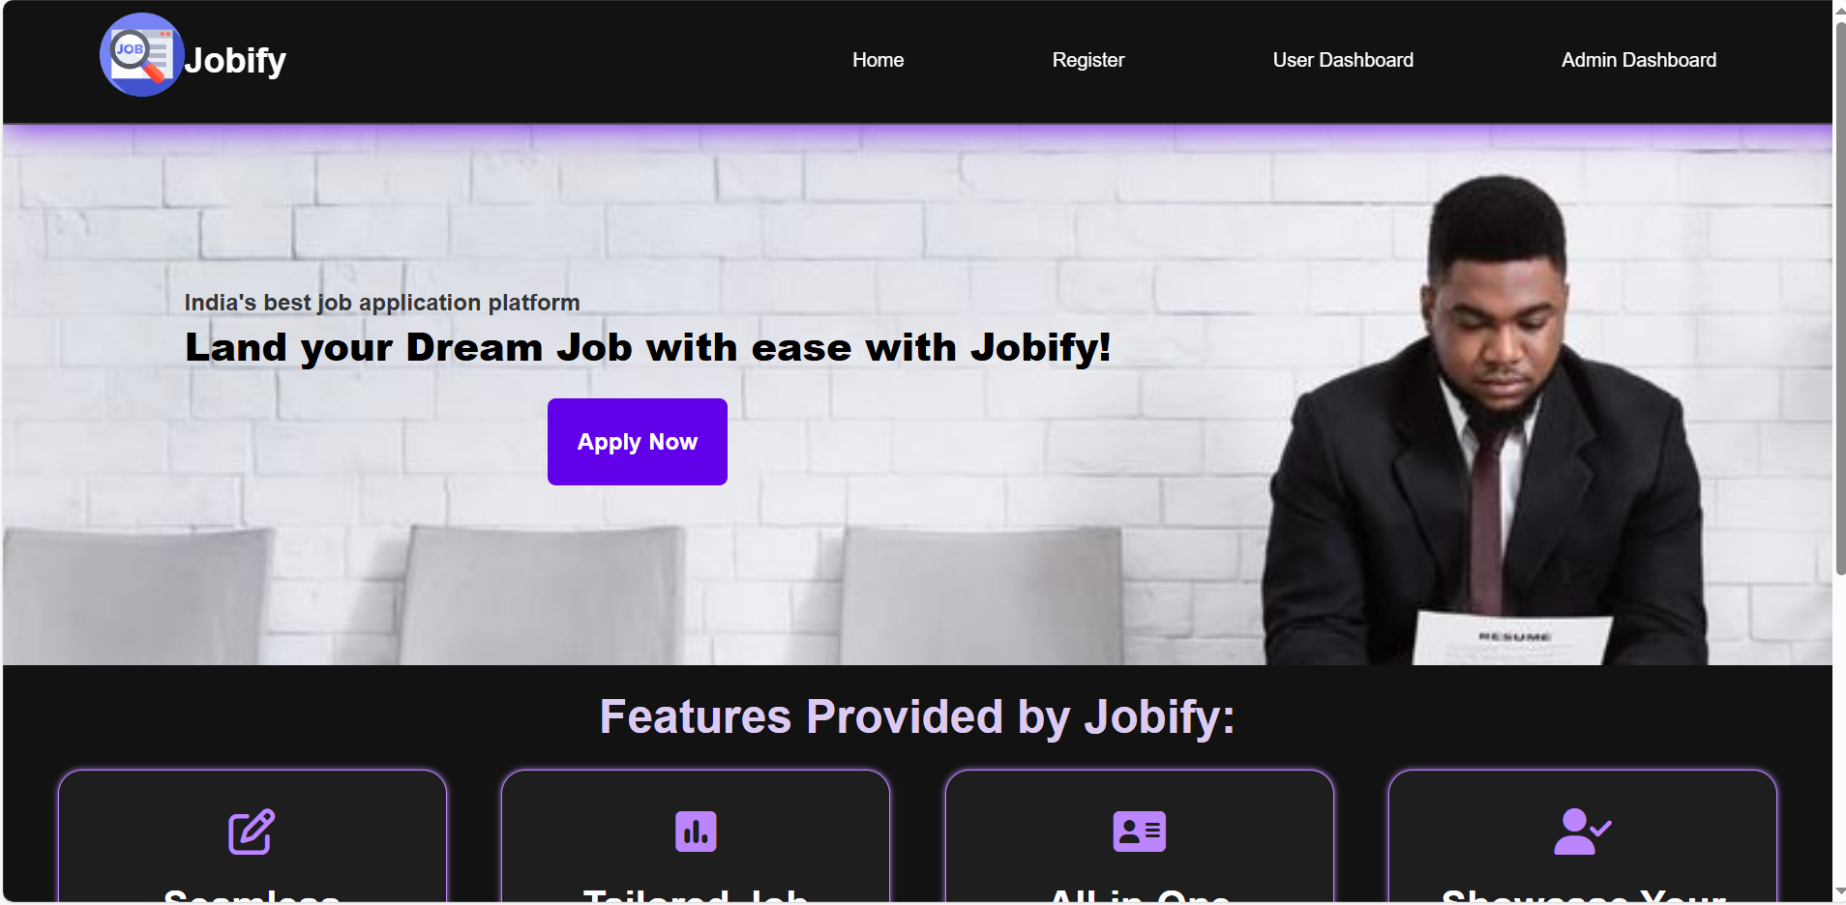
Project Highlights
5.1 Home Page

Slide 9
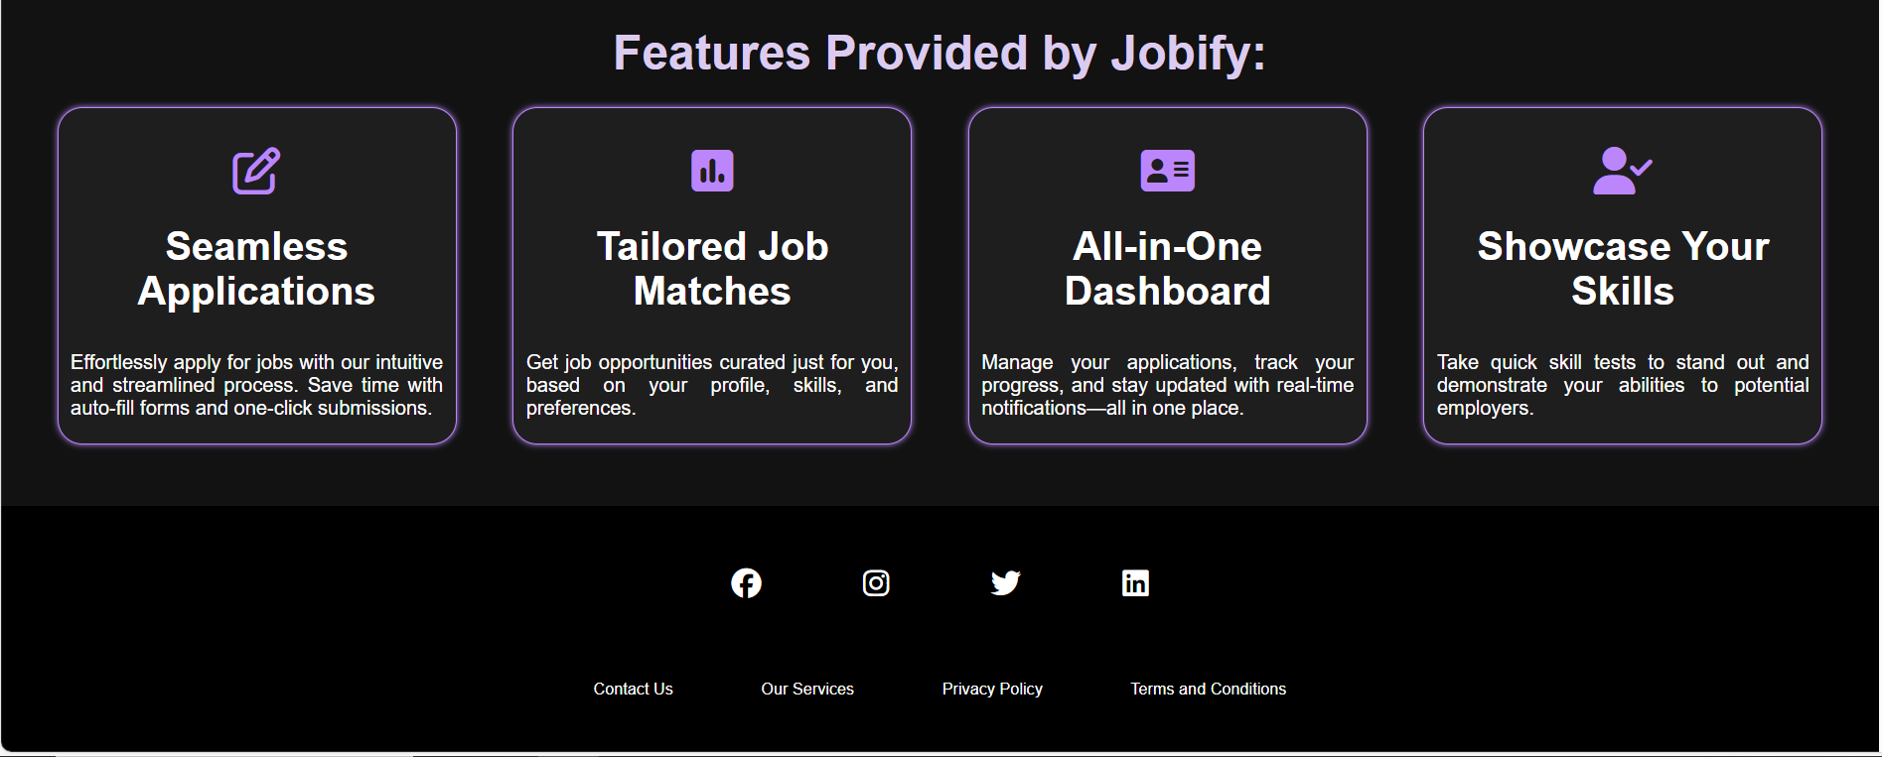
Highlights continued..
5.2 Home Page (Continued)

Slide 10
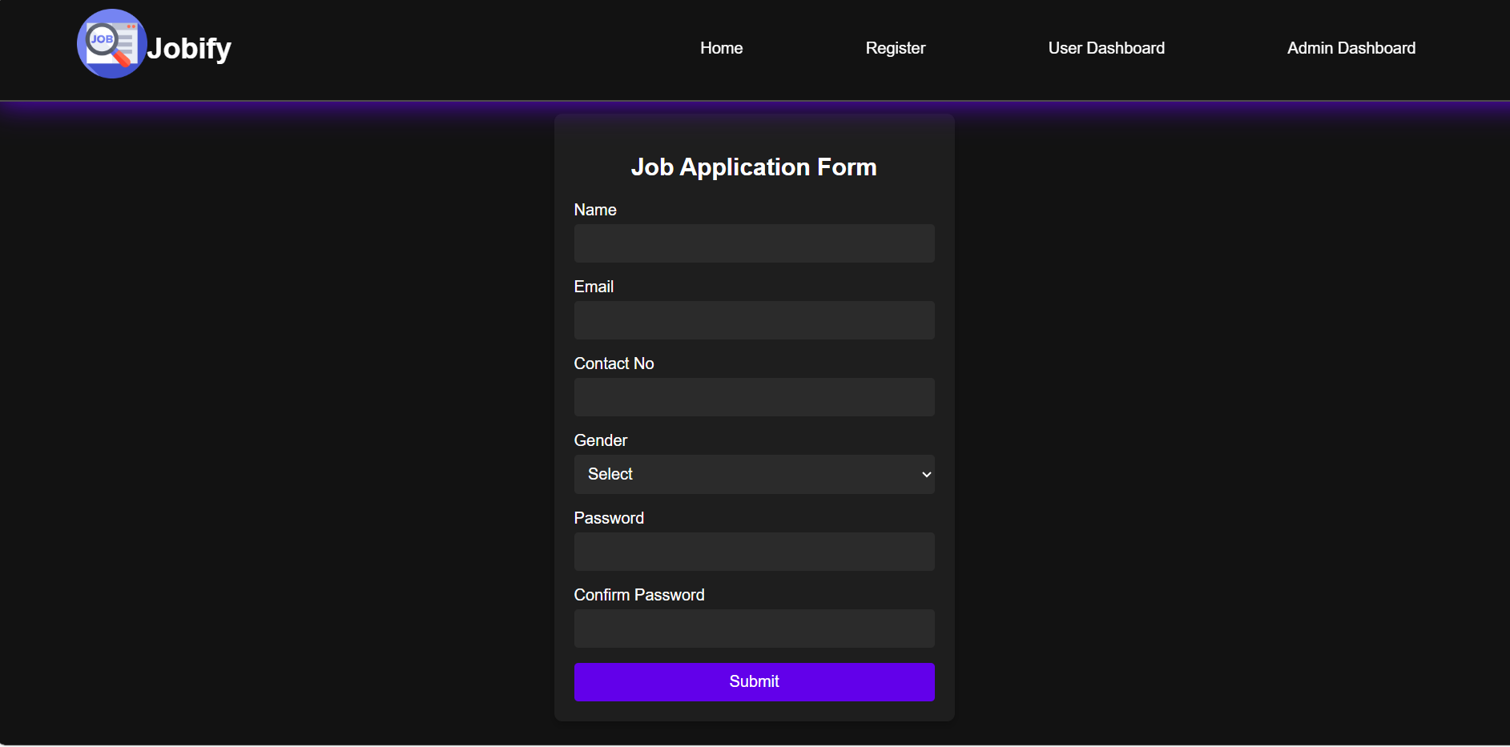
Highlights...
5.3 Application Form

Slide 11
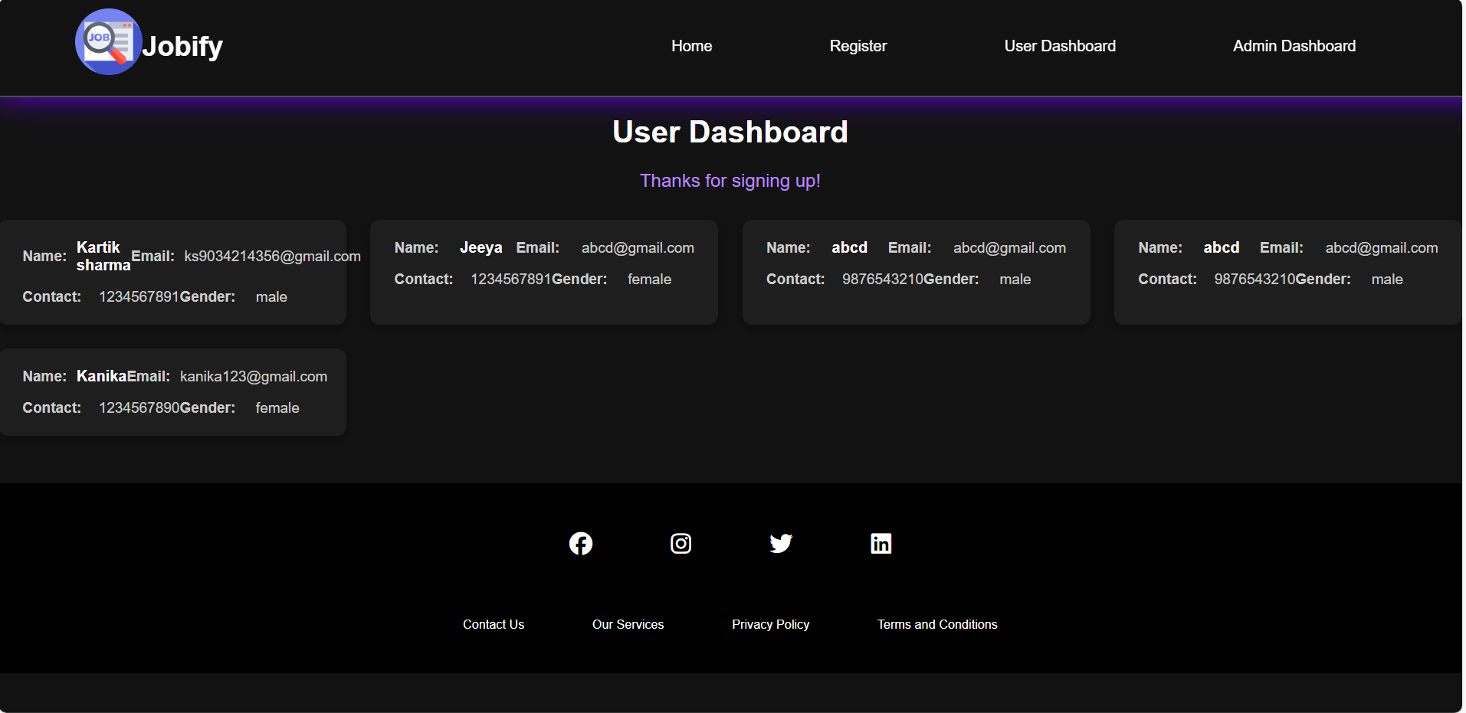
Highlights..
5.4 User Dashboard

Slide 12
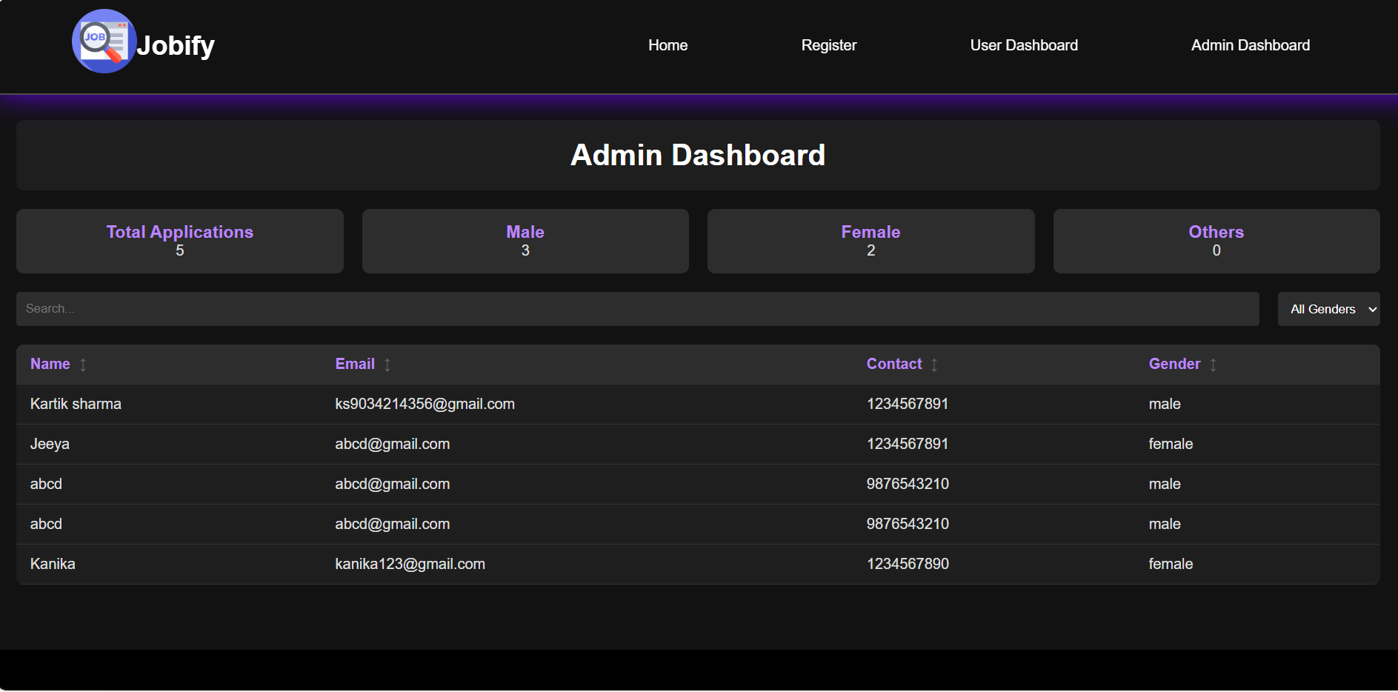
Highlights…
5.5 Admin Dashboard

Slide 13
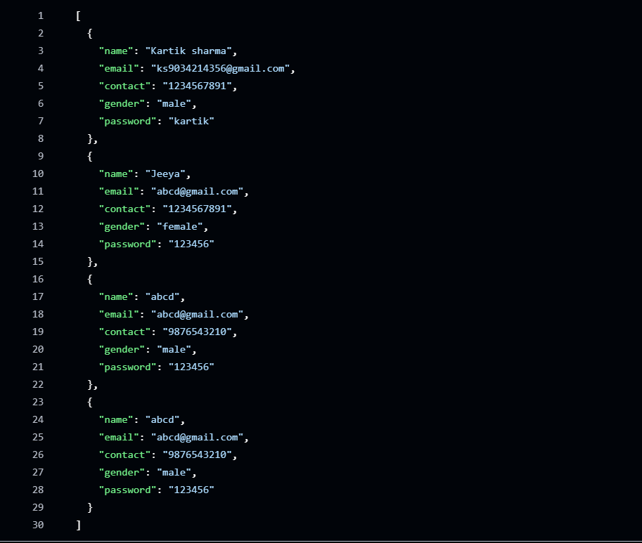
Highlights…
5.6 JSON File

Slide 14
Conclusion
Key points:
Jobify showcases a practical implementation of form validation and data storage using simple backend engineering concepts.
Emphasizes simplicity and reliability in handling user inputs and storing data securely.

Slide 15
References and Links
Node JS Documentation : https://nodejs.org/
MDN Web Docs: https://developer.mozilla.org/
Sites Used:
14

Slide 16


